Slide 1
Computer Graphics Perspective Camera
László Szécsi szecsi@iit.bme.hu
AIT

Slide 2
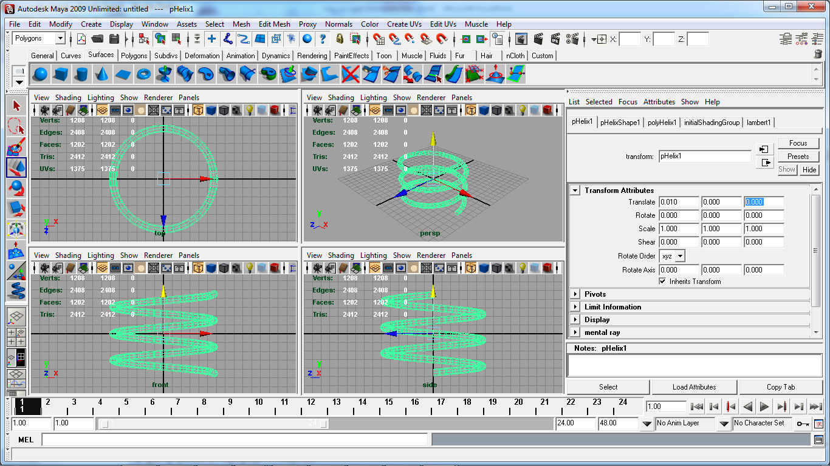
Coordinate systems: model space
Notes:
In 3D graphics, just as in 2D, we use transformations to pace our model instances into the virtual world, and to project them on-screen.
What coordinate spaces are there to speak of? What are the coordinate spaces we need to transform between?
In incremental rendering, we can think of the virtual world as a collection of triangles. Triangles form objects. Several objects may be identical, but placed at different positions and orientations. We say that these objects share the same geometric model. The most typical virtual world setups can be composed of instances of such models, instead of independent triangles.
Models are typically pre-made, and they do not change in runtime, even when rendering long sequences of images for an animation. They are authored using modeling software. The modeler artist can place triangle mesh vertices in a reference coordinate system called the model space. The triangle mesh is of course often obtained by tessellating analytic or free-form surfaces.
When we load the definition of a model from a file (e.g. the *.obj file format), the coordinates used in there are model coordinates. When we specify some geometry to be drawn for OpenGL, the coordinates we give in the vertex buffer are also model coordinates. Coordinates of points in other spaces must be found starting from these.

Slide 3
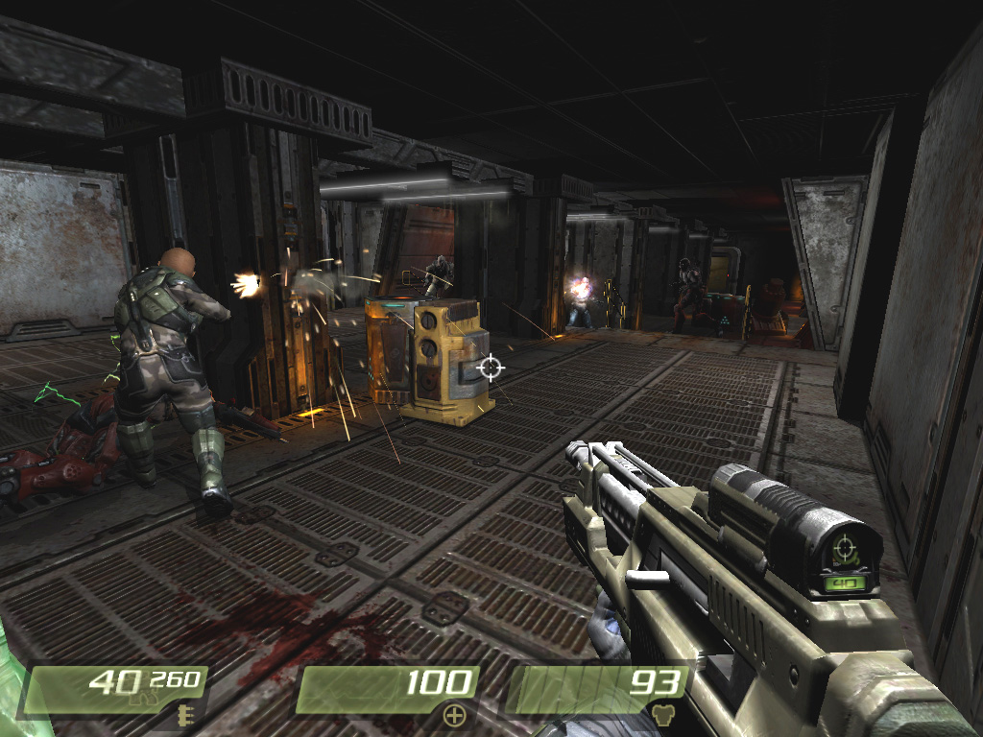
Coordinate systems: world space
Notes:
As said before, the virtual world is a collection of model instances. Where they are located and how they are oriented is specified with respect to the world space. This is one single absolute coordinate system, in which everything in the virtual world can be given, including light sources, camera parameters, etc. It is going to be safe to perform computation for illumination using world coordinates. These computations will include finding the distance between a light source and a shaded point, the incoming light angle, etc. For these, all parameters have to be expressed in the same coordinate system, of course.

Slide 4

Coordinate systems: camera space
up
right
ahead
y
eye
z
x
Notes:
To render images of a 3D virtual world, we have to specify a 3D camera. The position and orientation of the camera fixes a Cartesian coordinate system with the origin at the camera position, and the basis vectors the orthogonal right, up, and ahead direction vectors. Coordinates in the camera space tell us where points are with respect to this frame.

Slide 5
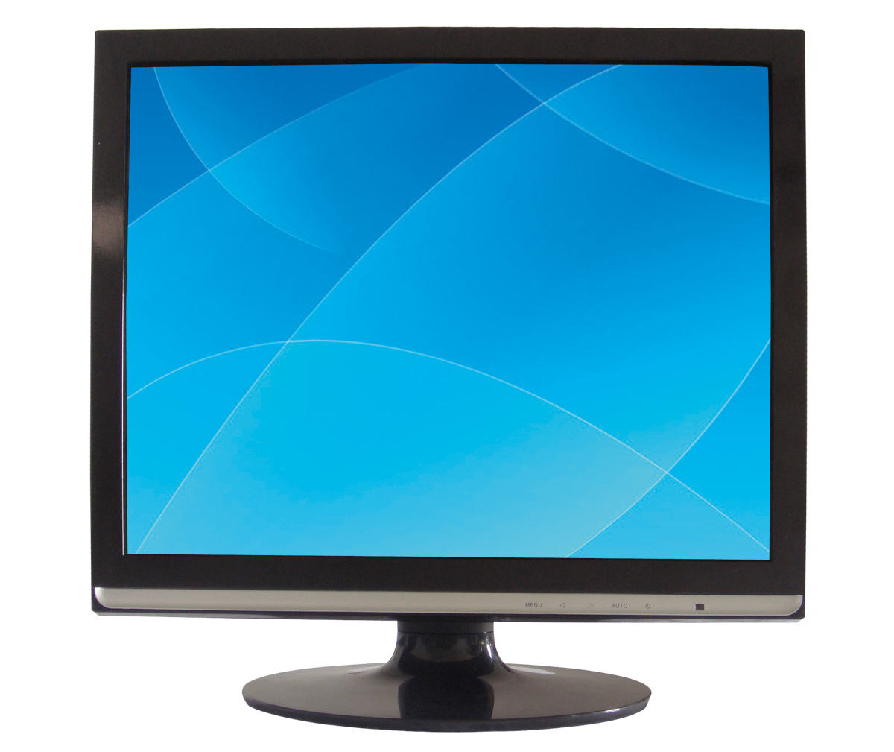
Coordinate systems: normalized device space
1
1
x
-1
-1
Notes:
Remember the normalized device space? NDC coordinates tell us where a point appears in the viewport.

Slide 6
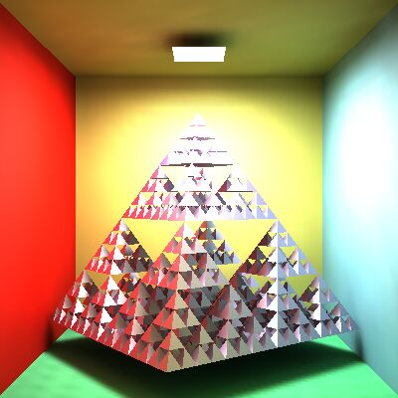
Coordinate systems: viewport space
pixel_{x}
resolution_{x}
pixel_{y}
p
resolution_{y}
Notes:
Viewport coordinates are the integer row and column indices of a pixel. To draw something, we eventually have to able to tell which pixels are to be colored.

Slide 7
Transformations
?
?
Given the coordinates of a point in one space, what are its coordinates in another space?
static interpretation
What should I do with the original coordinates, to get them in another space?
dynamic interpretation
Notes:
Transformations are operations on points. The point is expressed by a set of coordinates. A transformation will yield a new set of coordinates. This can simultaneously be seen to:
a, calculate coordinates for the same point in a different space (this I will call the static interpretation)
b, change the coordinates of the point, moving it (the dynamic interpretation).
Both interpretations are valid. The static one tells us what the purpose of the computation is, the dynamic often helps us in its construction.
Transformations are a way to compute answers to questions we will be encountering in graphics, and incremental image synthesis (i.e. what the classic GPU pipeline does) in particular. Questions like:
If the modeler has drawn this vertex here, and the object is standing here, where in the world is the vertex?
If the triangle was modeled here, where should we draw it on screen?

Slide 8
The incremental image synthesis problem
Given a tessellated 3D model
triangle vertices [model coordinates]
2D triangle drawing algorithm
colors pixels [viewport coordinates]
The task:
from the model coordinates of the vertex, compute in which pixel it appears
Notes:
The rasterizer unit in the GPU pipeline just draws triangles on-screen (and lines and points, but those hardly make 3D objects). The task really is: given the triangle mesh models in the reference model spaces, compute where to draw those 2D triangles on-screen, what pixels to color.
For a single triangle vertex point, this means a long journey of computations (transformations!) to find out where it actually appears on the display device.
Also, the transformations must take triangles and yield triangles. The class of transformations which has this property is called the class of homogeneous linear transformations. As they are linear, they can be written as a multiplication with a matrix. It is a 4x4 matrix, as it works on homogeneous coordinate quadruplets.

Slide 9
What would influence this?
Where our model is placed in the virtual world
model transformation, a.k.a. (world transformation)
Where the camera is, which way it looks
camera transformation
How big the field-of-view (and aspect ratio) are
perspective projection
How large pixels are
viewport transformation
Notes:
What are the parameters of such a computation? What influences where a vertex ends up on the screen?
Where our model is placed in the virtual world.
This is defined by the model transformation parameters, a.k.a. (world transformation).
Where the camera is, which way it looks
Defined by some of the camera parameters. The computation using these is the camera transformation.
How big the field-of-view (and aspect ratio) are
This plays are role in where the points are projected on-screen according to 3D perspective.
How large pixels are
Handled by the viewport transformation.

Slide 10
Additional task: visibility
the visibility problem
besides 2D pixel coordinates, some depth value must also be computed
fixed point Z-buffer hardware
compares depth values in [-1, 1]
distance mapped to -1 : front pane
mapped to 1: back pane
Notes:
If we just draw all triangles where they would appear on screen, triangles further away but drawn later will overwrite closer ones, occluding them. Thus, somewhere during our quest to find the device space coordinates of vertices, we need to solve the visibility problem: which triangle is visible in a pixel and which one is not. Only the visible one should be allowed to influence the final color of the pixel (assuming opaque objects for now).
How does this interfere with our calculation of device space coordinates? Well, NDC coordinates used to be 2D, just x and y. Not enough to tell what is closer or farther. We will also need a z, depth coordinate. Also, we are going to use some specialized hardware to compare those depth values, which works with values in the -1,1 range. Thus we will need to limit the depth range we are dealing with, and map that limited range to -1, 1. The limit values on z will constitute a back and a front pane, outside of which the geometry needs to be discarded for lack of depth comparison support. This discarding gives the panes the name of clipping panes.

Slide 11
Additional task: shading
Surface point coordinates, normal, lights, eye...
must be available in the same coordinate system
world coordinate system is logical
Notes:
When we get there, what color should we use to fill the triangles? It should of course be proportional to the amount of light arriving at the eye from the surface to the eye on red, green, and blue wavelengths. This will mean the evaluation of some illumination formula. This can be carried out in the world coordinate system, if every parameter is given in world coordinates.
(Note: the camera coordinate system has the same distances and angles, and is just as fit for the task, with the added benefit of the eye position being at the origin, and the added nuisance of needing to specify lights in camera coordinates.)

Slide 12
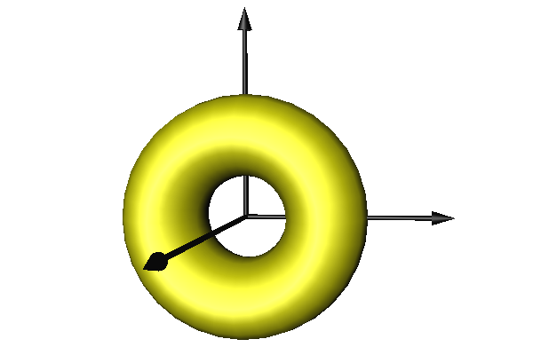
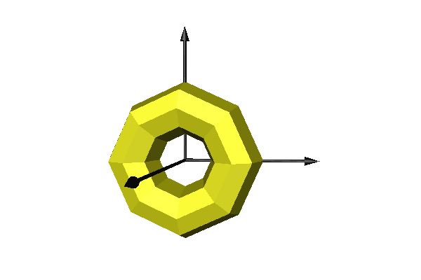
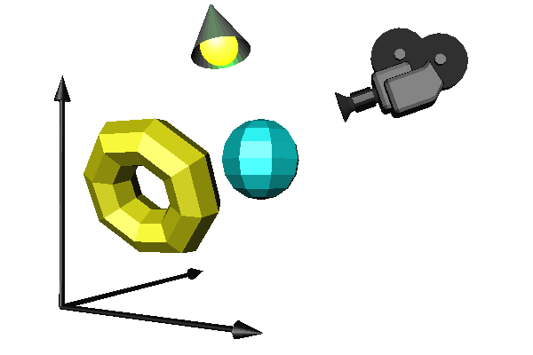
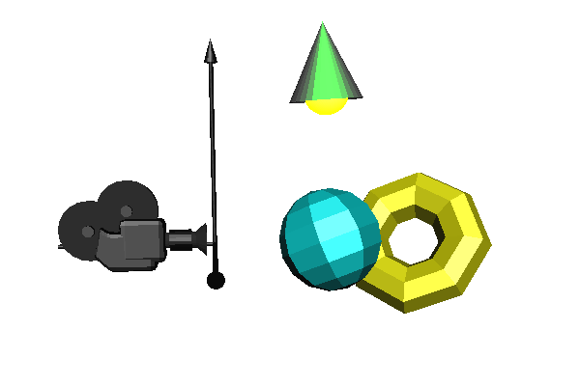


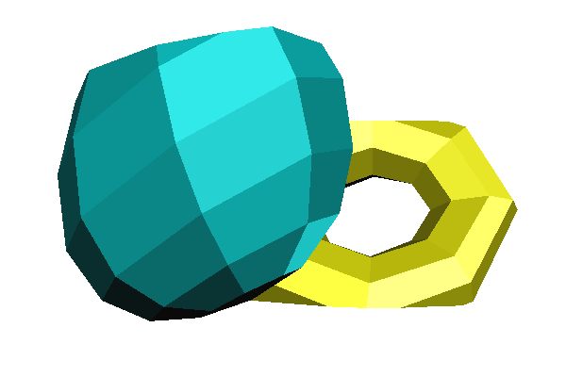
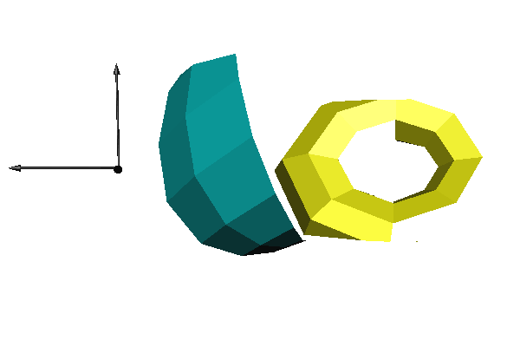
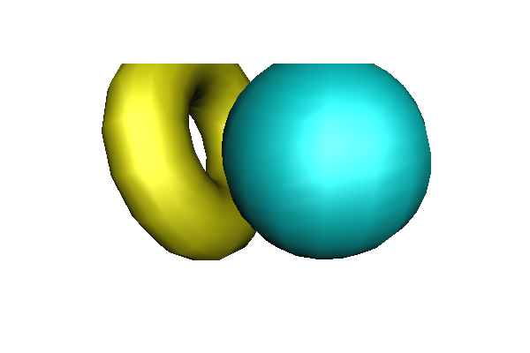

Rendering pipeline
view
transformation
model
transformation
Model in
reference state
Tessellation
World coordinates
Camera coordinates
perspective
projection
transformation
z
Normalized
Device coordinates.
Clipping
Viewport coordinates
Visibility
Image
Notes:
Incremental rendering is a pipeline of operations starting at the model and ending on the image. Objects are defined in their reference state. First, surfaces are approximated by triangle meshes. Then the tessellated object is placed in the world setting its real size, orientation and position. Here, different objects, the camera and light sources meet. Then, incremental rendering applies transformations to find a coordinate space where it is trivial to decide whether two points occlude each other, and projection is also simple. This is the screen space, where rays (lines through the eye and each pixel center) are parallel with axis z. To transform the model to screen coordinates, first we execute the camera transformation which translates and rotates the scene so that the camera is at the origin and looks at the –z direction (the negative sign is due to the fact that we prefer right handed coordinate system here). In the camera space, projection rays go through the origin and projection is perspective. To simplify this, we distort the space and make rays meet in an ideal point at the end of axis z, so projection rays will be parallel. Clipping is executed here. Finally, we take into account the real resolution of the image and scale the space accordingly.

Slide 13





Transformation pipeline
model
transform
view
transform
proj
transform
model space
world space
camera space
clip space
norm. device space
pixel
coordinates
viewport
space
modelling
viewport
transform
Notes:
The task of computing the pixel coordinates of a vertex from the modeling coordinates is performed by a series of transformations. Originally, the vertices are given in model space, then transformed to world space using the model transform, to camera space using the view transform, to NDC (a.k.a. clip space, for clipping will be performed using these coordinates), and finally to pixel coordinates using the viewport transform.
All the transformations take a 4-element homogenous 3D coordinate vector, and return a 4-element homogenous 3D coordinate vector. All transformations are linear in homogenous coordinates, they can all be written as 4x4 matrices. Transformation is multiplication by that matrix. A series of transformations can be performed as a single multiplication by a single compound transformation matrix obtained as a product of the element transformations.

Slide 14
Model and world coordinates (static interpretation)
model
world
Notes:
Recall that the virtual world contains model instances in different poses. The model transformation computes the world space coordinates of a model vertex for an object in a certain pose.
This interpretation tells us what we want to compute, but how the pose should be specified is not intuitive.

Slide 15
Model and world coordinates (dynamic interpretation)
Notes:
We can see this computation to move the model from its original reference position and orientation to its proper world pose. The transformation can be constructed using a rotation for the orientation, and a translation for the position.
So, performing a rotation and a translation will compute world space coordinates from model space coordinates. The transformation can be said to take the model from model space to world space. This interpretation is useful for the construction of the model transform.

Slide 16



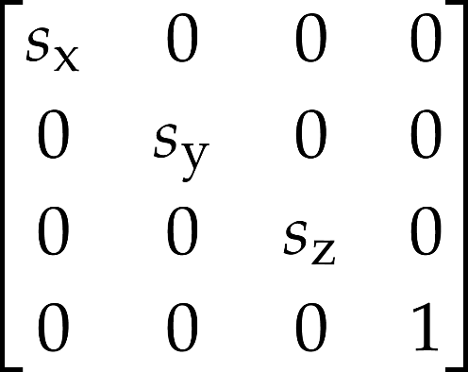
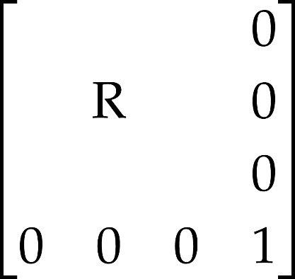
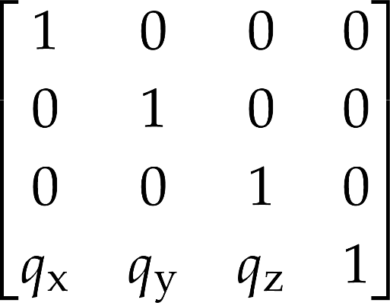

Model transformation
y
1. scaling:
2. orientation:
3. position:
z
x
model
trafo
matrix
Notes:
The model transformation sets up the object in the virtual world. This means scaling to set its size, then rotation to set its orientation, and finally translation to place it at its position. All three transformations are affine and can be given as homogeneous transformation matrices. Concatenating the matrices, we obtain a single modeling transformation matrix, which maps the object from its reference pose to its actual pose.

Slide 17




Transformation pipeline
✓
model transformation:
view transformation:
projection transformation:
composite transformation:
Notes:
Using the model transformation, the object is mapped to world coordinates.
From world coordinates, we go to camera space, where the camera is at the origin and looks along the –z direction. The view transformation between world and camera coordinates is a translation and a rotation.
After the view transformation, the next step is perspective transformation, which distorts the objects in a way that the original perspective projection will be equivalent to the parallel projection of the distorted objects. This is a non-affine transformation, so it will not preserve the value of the fourth homogeneous coordinates (which has been 1 so far).
The three transformation matrices (model, view, perspective) can be concatenated, so a single composite transformation matrix takes us from the reference state directly to normalized screen space.

Slide 18
Where to draw the point on-screen?
camera and projection transformations are to compute this
view transformation
position relative to camera
projection
where is it projected on the viewport rectangle?
viewport transformation
which pixel
[1 1]
[-1 -1]
[0 0]
[345 234]
Notes:
So after the model transformation, all remaining transformations are to answer the question of where a point should appear on the display. The computation is decomposed into two major steps: the view and projection parts.

Slide 19
Camera model
eye
screen
generic upwards
front clipping plane
up
fov
eye
asp
back clipping plane
z
lookat
y
x
Pine-hole camera
Camera obscura
Notes:
For 3D image synthesis, we would like our screen to act as a window opened on a 3D virtual world. Where that window is located in the virtual world, what its size is, and from how far we are looking at it, will all influence what we would be seeing on the screen. In order to synthesize the image, these have to be given---we call them the parameters of our camera model.
The definition of the camera and projection transformations depends on the parameters of the camera. In computer graphics the camera is the eye position that represents the user in the virtual world and a window rectangle that represents the screen.
Indeed, real cameras do the same: create a 2D image from a 3D world. We are not willing to care about lens systems, or sacrifice processing power in order to simulate their intricacies. Thus, we use a very simple camera model, that of the pinhole camera. As light rays pass through a point-like hole, the image of the outside world is projected onto the back wall of the camera chamber, forming an upside-down and left-on-the-right image of it. In order to limit the projected image to a rectangle of certain size, we can apply shades in front of the pinhole in a pyramidal configuration.
It does not matter where the back wall is. Sure, the size of the projected image would be different, but otherwise it would be the same. In computer image display, the dimensions of the image will be scaled to the size of the viewport on-screen eventually, so it is irrelevant what the size in the camera model would be. The angles of the pyramidal shades do make a difference, of course! They control how much of the outside world will be visible in the image.
So, it does not matter where the back wall is. Could it be in front of the pinhole? Certainly not in a real pinhole camera, but in a virtual one, why not? Then our image will not even be flipped in any way. This is the configuration we are going to assume for our camera from now on.
So, what are the parameters of such a camera?
world space camera position: eye
world space camera orientation: e.g. by giving ahead, right and up vectors of the camera frame
Instead of explicitly giving the ahead, right and up vectors of the camera frame (which are required to be unit length and orthogonal), a more intuitive set of equivalent parameters is customary. Instead of the ahead direction, we give a lookat point in that direction (this point should appear in the center of the image). Note that this does not completely define camera orientation, as it may be rolled left or right while still looking at the lookat point. Therefore, the additional condition is usually assumed that the camera stays as upright as possible (with respect to a generic upwards direction).
As discussed above, the actual size or location of the window rectangle does not matter, but the angles of the pyramid connecting the eye to the window do. To set the vertical extents, the field of view angle (fov) is given. For the horizontal size, the aspect ratio of the vertical and horizontal window edge sizes should be specified. To avoid distortions when mapping the resulting image to our display (render window, canvas), this aspect ratio should correspond to that of the display.
To solve the visibility problem later, we will only be able to handle a bounded range of depth. Anything in front of the front clipping pane or behind the back clipping plane will be discarded, and not visible on screen. Where these planes are is also part of the camera definition.

Slide 20
View transformation (static interpretation)
camera
world
Notes:
The camera transform computes vertex coordinates relative to the camera. This is a similar setup to that of the model (the camera can also be characterized by a world space position and orientation, just like a model instance), only backwards.

Slide 21
Reminder: View transformation – 2D camera, OrthoCamera
Where does this vertex go on the screen?
also:
What do I do with everything in the world, to get this part in particular on my screen?
1
-1
Notes:
Screen projection maps the window rectangle, which is the camera in 2D, onto the viewport rectangle, which can be imagined as the photograph. This simple projection is usually executed in two steps, first transforming the window onto a normalized square, and then transforming the square to the viewport.
Transforming the window to a origin centered square of corners (-1,-1) and (1,1) is a sequence of three transformations: a translation that moves the bottom-left corner of the window to the origin; a scaling that modifies the window width and height to 2; a translation that moves the origin to (-1,-1). This is an affine transformation that can also be given as a matrix.
Transformation of the origin centered square to the viewport is similar.

Slide 22
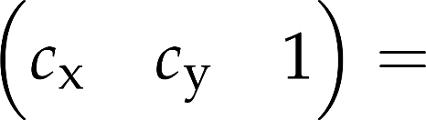
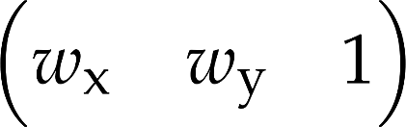


1
-1

Slide 23

1
-1

Slide 24
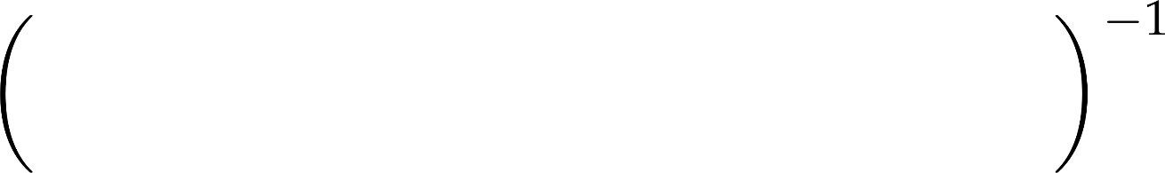
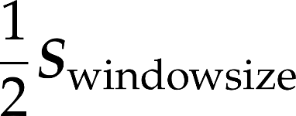


1
-1

Slide 25
Let's do the same in 3D
Where does this vertex go on the screen?
also:
What do I do with everything in the world, to get this part in particular on my screen?
1
-1
Notes:
Screen projection maps the window rectangle, which is the camera in 2D, onto the viewport rectangle, which can be imagined as the photograph. This simple projection is usually executed in two steps, first transforming the window onto a normalized square, and then transforming the square to the viewport.
Transforming the window to a origin centered square of corners (-1,-1) and (1,1) is a sequence of three transformations: a translation that moves the bottom-left corner of the window to the origin; a scaling that modifies the window width and height to 2; a translation that moves the origin to (-1,-1). This is an affine transformation that can also be given as a matrix.
Transformation of the origin centered square to the viewport is similar.

Slide 26


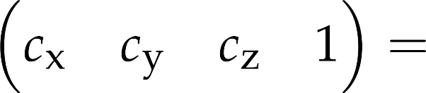
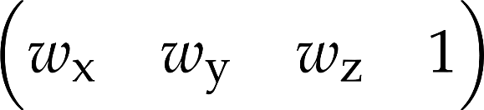

1
-1

Slide 27
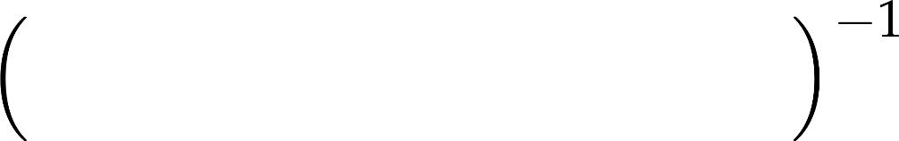




1
-1
the view matrix

Slide 28

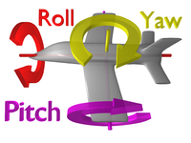
Yaw-pitch-roll: a way to specify camera orientation
y
right-handed
main directions
x: right
y: up
z: back (ahead is -z)
rotation angles:
yaw – around y
pitch – around x
roll – around z
x
z

Slide 29
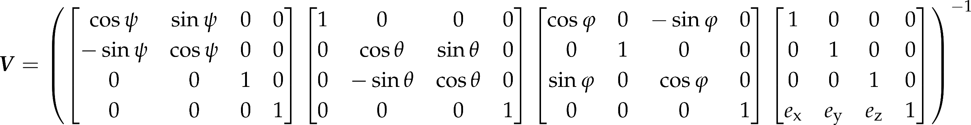
Yaw-pitch-roll view matrix
this is a great orientation representation for mouse control
mouse movements change angles
roll
pitch
yaw

Slide 30
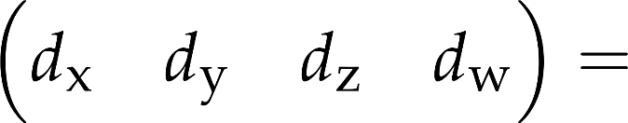
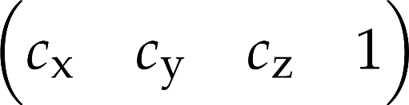


1
-1
the projection matrix

Slide 31
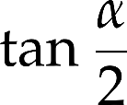
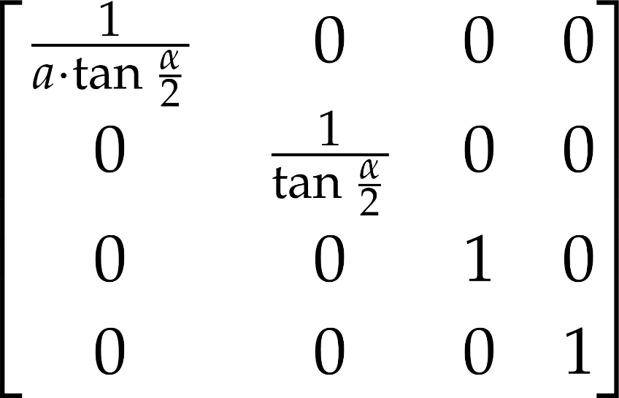
Normalization
field of view angle (FOV)
1
aspect ratio
90 degrees
field of view
Notes:
In camera space, the camera is in the origin and the main viewing direction is axis –z. The normalization step distorts the space to make the viewing angle be equal to 90 degrees. This is a scaling along axes y and x. Considering scaling along axis y, before the transformation the top of the viewing pyramid has y coordinate bp·tg(fov/2), and we expect it to be bp. So, y coordinates must be divided by tg(fov/2). Similarly, x coordinates must be divided by tg(fov/2)·asp.

Slide 32
Projection transformation (static interpretation)
1
y
1
-1
z
screen coordinates: (y/z, 1)
in homogenous coordinates (y/z, 1, 1)
or (y, z, z)
Notes:
Projection computes where the point is seen on-screen (NDC coordinates, -1, 1). Already having the camera z and camera y, this is not a complicated task. Consider the similar right angled triangles to find that the (camera space) distance for the screen centre is y/z. If the FOV is 90 degrees, this is identical to NDC coordinate, otherwise we have to scale according to the virtual screen size (tan FOV/2).
So, the NDC coordinates of a point projected to the screen are (y/z, 1). In homogeneous coordinates, this can be written as (y, z, z). Without division! That is because we rely on the homogeneous division to do that for us, should anyone ever want to get the Cartesian coordinates.
Note that in this slide we did not care about the signs of the coordinates (it is actually –z, not z), and we just computed the projected z to be one (assuming a screen at unit distance), which is not a useful piece of information. The actual projected depth has to be something we can use for depth comparisons.

Slide 33
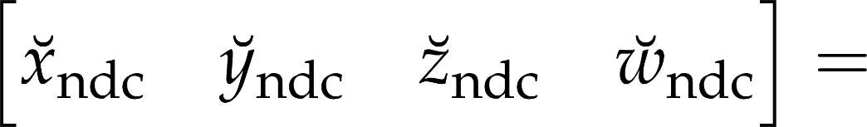
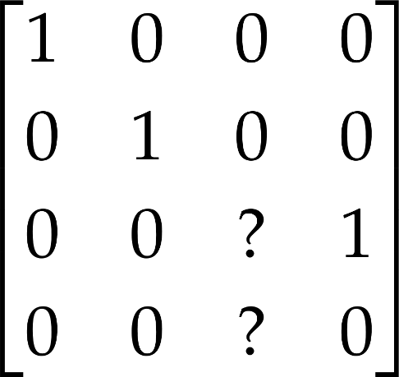

Division as a matrix product? Only in homogeneous coords!
what matrix comes here?

Slide 34
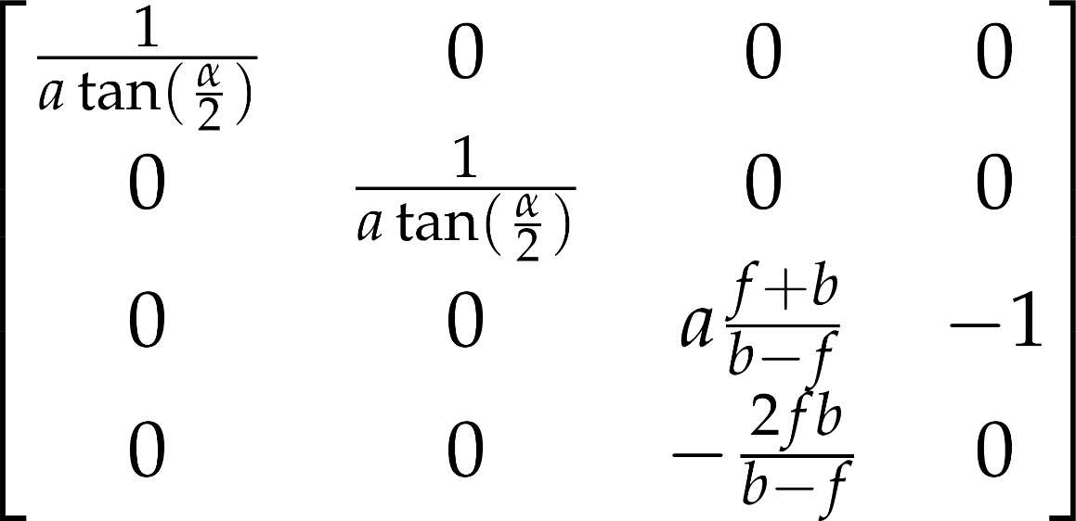


Perspective projection with depth
y
z
1
Notes:
Normalization and perspective transformation are usually combined and the composed transformation is set directly.
It is worth noting that this transformation sets the fourth homogeneous coordinate to the (negative) camera coordinate depth value. It is also notable that this transformation maps the eye ([0,0,0,1] in homogeneous coordinates) to the ideal point of axis z, i.e. to [0,0, -2fp ·bp/(bp-fp), 0] ∼[0,0, 1, 0].

Slide 35
PerspectiveCamera.kt
3D perspective camera object
must set view, projection matrices
moveable by mouse and WASD keys

Slide 36
PerspectiveCamera.kt – import
import vision.gears.webglmath.UniformProvider
import vision.gears.webglmath.Vec2
import vision.gears.webglmath.Vec3
import vision.gears.webglmath.Mat4
import kotlin.math.tan
import org.w3c.dom.events.*

Slide 37
Camera parameters
class PerspectiveCamera(vararg programs : Program) : UniformProvider("camera") {
val position by Vec3(0.0f, 0.0f, 0.0f)
var roll = 0.0f
var pitch = 0.0f
var yaw = 0.0f
var ahead = Vec3(0.0f, 0.0f,-1.0f)
var right = Vec3(1.0f, 0.0f, 0.0f)
var up = Vec3(0.0f, 1.0f, 0.0f)
right-handed coordinate system:
x right, y up, z backwards

Slide 38
Projection parameters
var fov = 1.0f
var aspect = 1.0f
var nearPlane = 0.1f
var farPlane = 1000.0f

Slide 39
Properties for moving
var speed = 0.005f
var isDragging = false
val mouseDelta = Vec2(0.0f, 0.0f)

Slide 40
Matrices
val rotationMatrix = Mat4()
val viewProjMatrix by Mat4()
val rayDirMatrix by Mat4()

Slide 41
Global world up direction
companion object {
val worldUp = Vec3(0.0f, 1.0f, 0.0f)
}

Slide 42
Computing the view matrix
rotationMatrix.set().
rotate(roll).
rotate(pitch, 1.0f, 0.0f, 0.0f).
rotate(yaw, 0.0f, 1.0f, 0.0f)
viewProjMatrix.set(rotationMatrix).
translate(position).
invert()

Slide 43
Computing the proj matrix
val yScale = 1.0f / tan(fov * 0.5f)
val xScale = yScale / aspect
val f = farPlane
val n = nearPlane
viewProjMatrix *= Mat4(
xScale , 0.0f , 0.0f , 0.0f,
0.0f , yScale , 0.0f , 0.0f,
0.0f , 0.0f , (n+f)/(n-f) , -1.0f,
0.0f , 0.0f , 2*n*f/(n-f) , 0.0f)

Slide 44
Use camera
!
create perspective camera in Scene, replacing the 2D orthographic one
change camera position in constructor
set camera farther from/closer to object
change field of view
change near and far planes

Slide 45
Motion: yaw, pitch drag
yaw rotates left, around y
when I drag right, turn right
fun move(dt : Float, keysPressed : Set<String>) {
if(isDragging) {
yaw -= mouseDelta.x * 0.002f
pitch -= mouseDelta.y * 0.002f
if(pitch > 3.14f/2.0f) { pitch = 3.14f/2.0f }
if(pitch < -3.14f/2.0f) {
pitch = -3.14f/2.0f
}
mouseDelta.set()
}
pitch rotates around x, upwards
when I drag down, turn down

Slide 46
Motion: update main direction from the angles
ahead = (Vec3(0.0f, 0.0f, -1.0f).xyz0 * rotationMatrix).xyz
right = (Vec3(1.0f, 0.0f, 0.0f).xyz0 * rotationMatrix).xyz
up = (Vec3(0.0f, 1.0f, 0.0f).xyz0 * rotationMatrix).xyz

Slide 47
Setting the aspect ratio
fun setAspectRatio(ar : Float) {
aspect = ar
update()
}

Slide 48
Event handlers – they must be called, too!
fun mouseDown() {
isDragging = true
mouseDelta.set()
}
fun mouseMove(event : MouseEvent) {
mouseDelta.x += event.asDynamic().movementX as Float
mouseDelta.y += event.asDynamic().movementY as Float
event.preventDefault()
}
fun mouseUp() {
isDragging = false
}
}

Slide 49
Camera rotation by mouse
!
connect events
call respective camera methods from event handlers
call camera.move in every frame

Slide 50
Motion: translation with keys
if("W" in keysPressed) { position += ahead * (speed * dt) }
if("S" in keysPressed) { position -= ahead * (speed * dt) }
if("D" in keysPressed) { position += right * (speed * dt) }
if("A" in keysPressed) { position -= right * (speed * dt) }
if("E" in keysPressed) { position += up * (speed * dt) }
if("Q" in keysPressed) { position -= up * (speed * dt) }

Slide 51
Camera motion on WASDQE keys
!
note there is a speed property

Slide 52

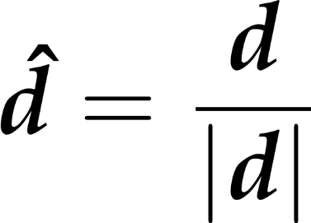
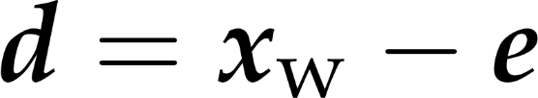
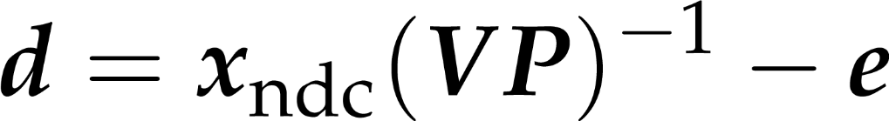
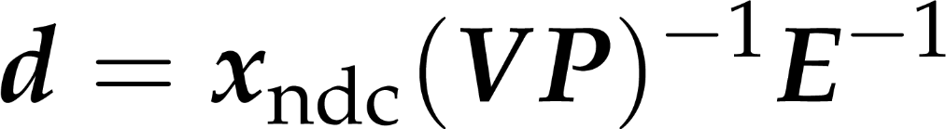
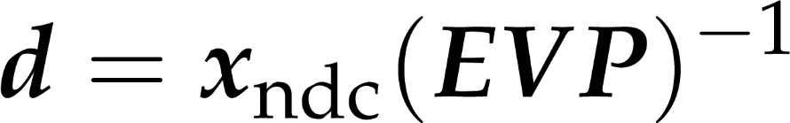
Compute ray direction from NDC
(EVP)⁻¹ is what we call the rayDirMatrix

Slide 53
On update
rayDirMatrix.set().translate(position)
rayDirMatrix *= viewProjMatrix
rayDirMatrix.invert()

